Slide 1


//Developers_Institute_
TLV Coding Bootcamp
</MY PROJECT NAME>
Developers Institute ranked for Best Coding Bootcamp Worldwide for 2023
Azerbaijan 🇦🇿- México 🇲🇽 - Cameroon 🇨🇲 - Senegal 🇸🇳 - Burkina Faso 🇧🇫 - Mali 🇲🇱 - Ghana 🇬🇭 - Togo 🇹🇬 - Mauritius 🇲🇺 - Morocco 🇲🇦 - India 🇮🇳 - Georgia 🇬🇪 - Israël 🇮🇱

Slide 2
UrbanPulse
Description:
UrbanPulse is a tool designed to analyze traffic flows in Paris in a visual and interactive way. The primary goal is to provide actionable insights to understand congestion periods, identify problematic zones, and support decision-making.
Motivation:
Paris faces significant traffic congestion, impacting daily commutes, pollution, and urban life. This project aims to provide actionable insights to tackle these challenges effectively.

Slide 3
Project Overview
UrbanPulse consolidates traffic data to create dynamic visualizations, helping users understand traffic trends by time, location, and state.
Purpose and Objectives:
Provide a clear understanding of traffic flow.
Support decision-making for urban planners and policymakers.
Enhance public transportation and route planning.
Real-Life Problems Solved:
Traffic congestion and delays.
Inefficient urban traffic management.
Lack of centralized, user-friendly traffic insights.

Slide 4
Solution and Benefits
Solution Provided:
A dashboard combining Python-powered data cleaning and Tableau visualizations.
Features include heatmaps, interactive maps, and statistical insights.
Addressing the Problems:
Pinpoints high-traffic areas and peak congestion times.
Provides actionable data for improving traffic management.
Benefits:
Reduced commute times.
Data-backed decision-making for urban development.
Improved understanding of traffic dynamics.

Slide 5
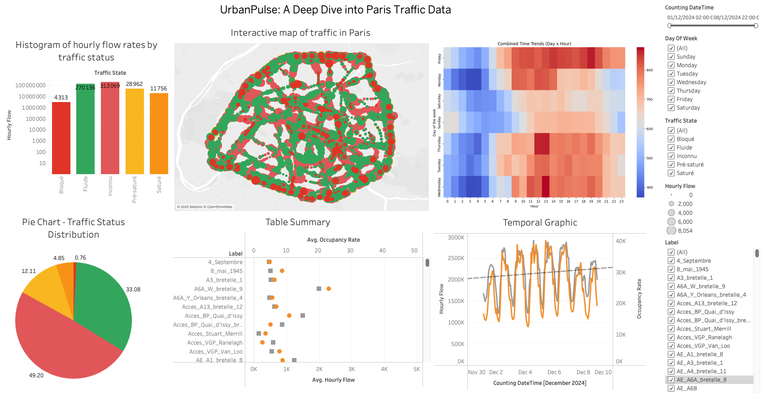
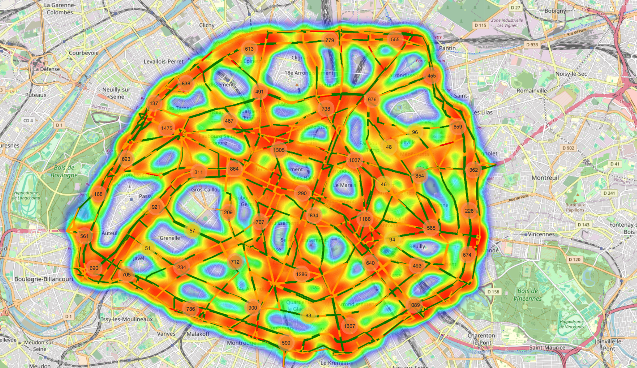
Demonstration
Features in Action:
Interactive Map: Displays traffic density across Paris.
Heatmap: Highlights hourly and daily congestion patterns.
Pie Charts and Histograms: Provide traffic state distributions and hourly flow insights.
urbanpulse

Slide 6
Challenges Faced
Key Obstacles
Data Volume: Handling large datasets (~500MB) with multiple columns.
Data Quality: Dealing with missing, inconsistent, or outlier values.
Integration: Combining Python visuals with Tableau dashboards.
Performance: Ensuring the dashboard remains interactive and responsive.

Slide 7
Solutions to Challenges
Overcoming Obstacles:
Data Volume: Optimized data processing with Pandas and efficient memory usage.
Data Quality: Applied statistical methods for outlier detection and missing value imputation.
Integration: Exported Python-generated heatmaps as images for seamless Tableau integration.
Performance: Filtered datasets for faster visualization rendering.

Slide 8
Future Steps
Next Steps for Improvement:
Real-Time Traffic Monitoring: Connect the dashboard to live traffic APIs.
Predictive Analytics: Use machine learning to forecast traffic trends.
Scaling Beyond Paris: Adapt the solution to other cities.
Advanced Insights: Introduce environmental impact and public transport data.

Slide 9
Summary Points
Main Takeaways:
UrbanPulse merges data analysis and visualization to address real-world traffic issues in Paris.
The project showcases Python for preprocessing and Tableau for dynamic insights.
The dashboard is designed to support smarter urban planning and decision-making.

Slide 10
Conclusion
Impact of UrbanPulse:
A step toward efficient traffic management in Paris.
A versatile tool for urban planners, transport companies, and researchers.
Final Thoughts:
UrbanPulse demonstrates how data and technology can improve urban mobility and enhance quality of life.

Slide 11
Link
Github
Portofolio
Linkedin
Dashboard
Interactive Map

